Slide 1
Physical Layer Signal and Modulation
LECTURE 10

Slide 2
Contents
Signal
Digital Data and Signal
Fourier analysis and Fourier Transform
Time domain and Frequency domain mapping
Bandwidth and Channel Capacity

Slide 3
Signal

Slide 4
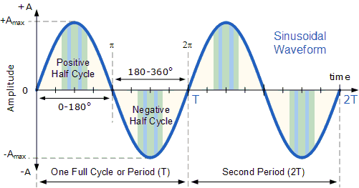
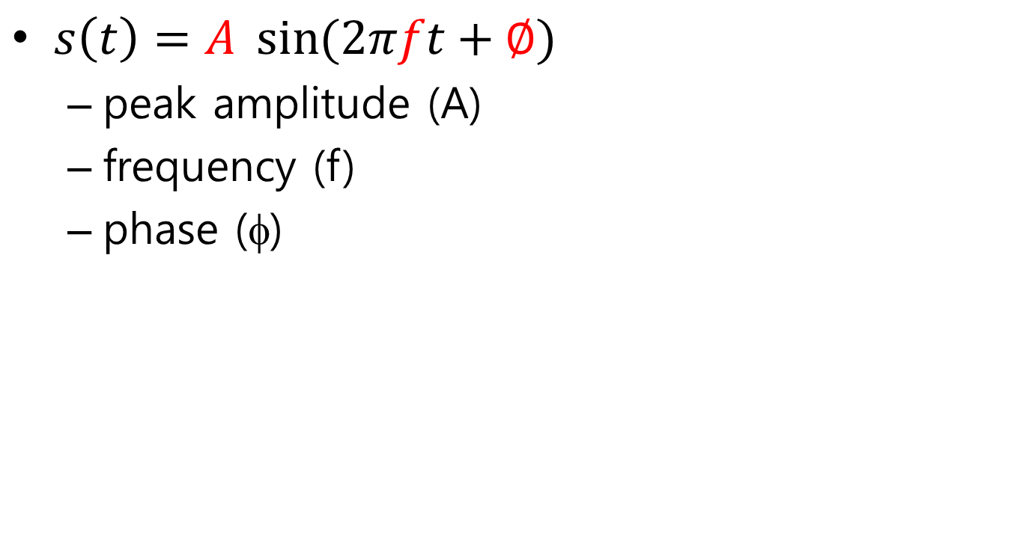
Sine Wave
$s\left(t\right)=A \sin{(2πft}+∅)$
peak amplitude (A)
frequency (f)
phase (φ)

Slide 5
Sine Wave
peak Amplitude (A)
Maximum strength of signal
typically measured in volts
Frequency (f)
The number of the signal repetition per second
Hertz (Hz) = cycles/second
Period (T)
the amount of time for one repetition
T = 1/f
Phase (φ)
relative position in time within a single period of signal
radian

Slide 6
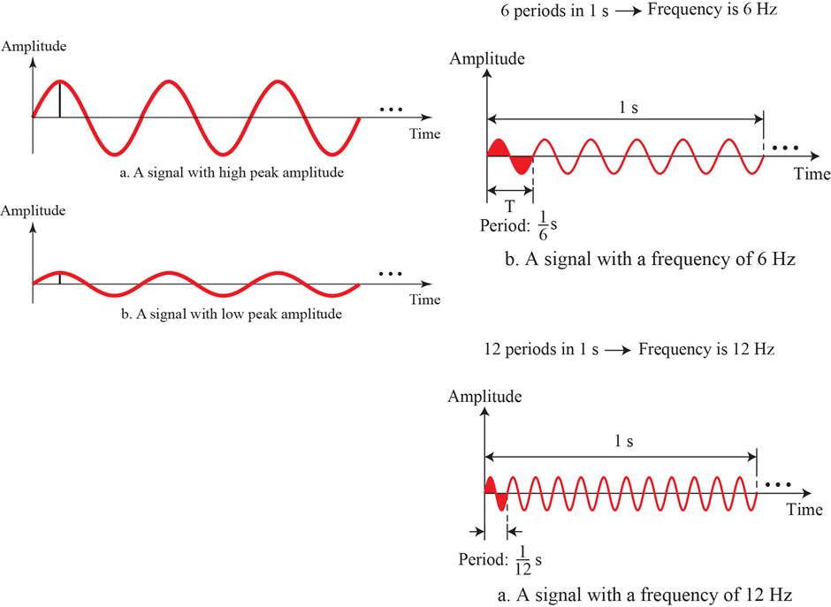
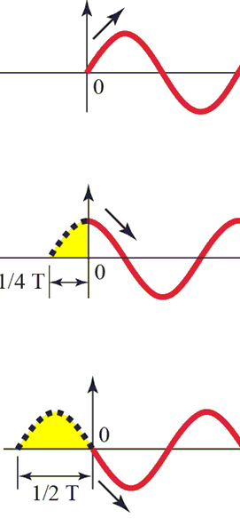
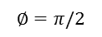
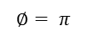
Sine Wave A, f=1/T, φ
$$∅=π/2$$
$$∅= π$$

Slide 7
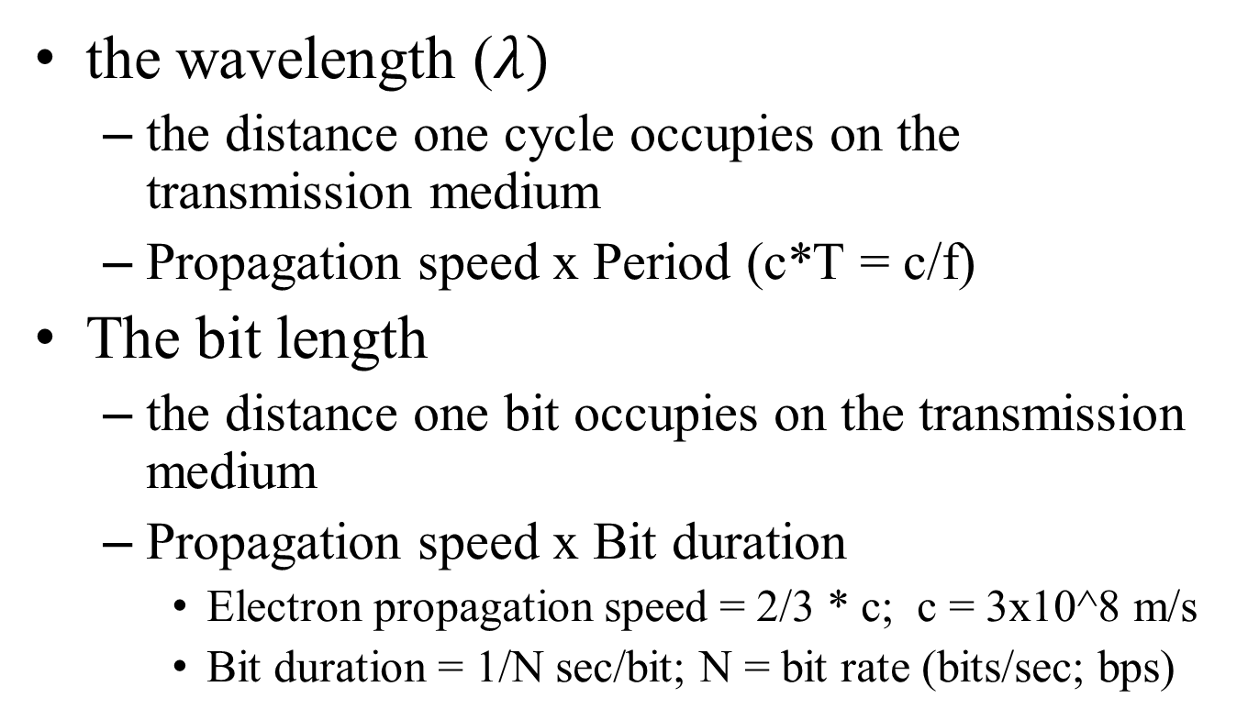
Wave Length and Bit Length
the wavelength ($λ)$
the distance one cycle occupies on the transmission medium
Propagation speed x Period (c*T = c/f)
The bit length
the distance one bit occupies on the transmission medium
Propagation speed x Bit duration
Electron propagation speed = 2/3 * c; c = 3x10^8 m/s
Bit duration = 1/N sec/bit; N = bit rate (bits/sec; bps)

Slide 8
Digital Data and Signal

Slide 9
Data Rate vs Signal Rate
Data
Individual facts, statistics, or items of information
Signal
An electrical quantity or effect, as current, voltage, or electromagnetic waves, that can be varied in such a way as to convey information
http://www.dictionary.com/

Slide 10
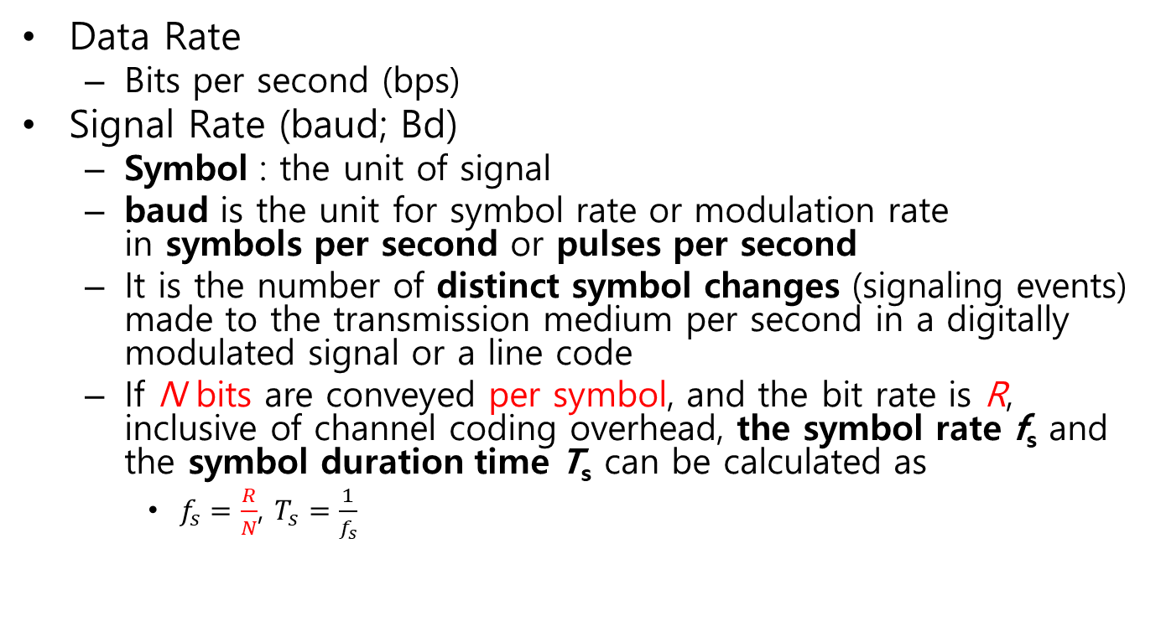
Data and Signal
Data Rate
Bits per second (bps)
Signal Rate (baud; Bd)
Symbol : the unit of signal
baud is the unit for symbol rate or modulation rate in symbols per second or pulses per second
It is the number of distinct symbol changes (signaling events) made to the transmission medium per second in a digitally modulated signal or a line code
If N bits are conveyed per symbol, and the bit rate is R, inclusive of channel coding overhead, the symbol rate f_{s} and the symbol duration time T_{s} can be calculated as
$f_{s}=\frac{R}{N}$, $T_{s}=\frac{1}{f_{s}}$

Slide 11
Bandwidth

Slide 12
Bandwidth
Bandwidth
The difference between the upper and lower frequencies in a continuous set of frequencies
It is typically measured in hertz
Passband bandwidth
the difference between the upper and lower cutoff frequencies of, for example, a band-pass filter, a communication channel, or a signal spectrum
In the case of a low-pass filter or baseband signal, the bandwidth is equal to its upper cutoff frequency

Slide 13
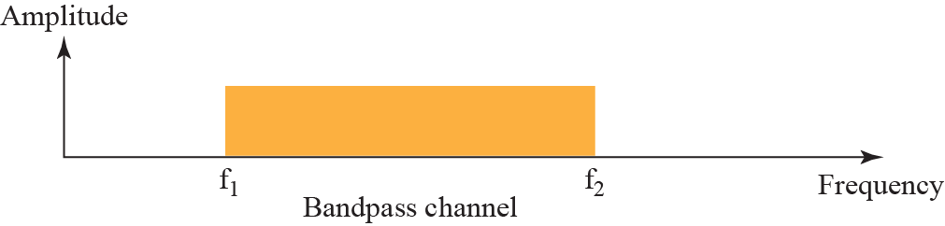
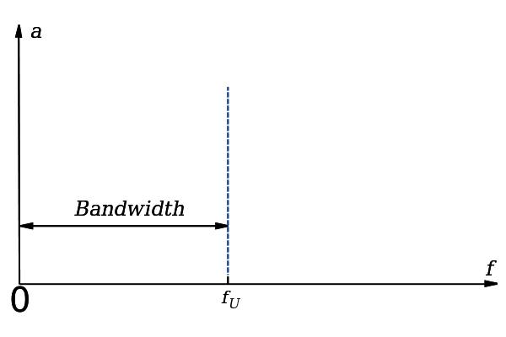
Bandwidth
signal spectrum
communication channel
band-pass filter
Passband bandwidth
Baseband signal
low-pass filter

Slide 14
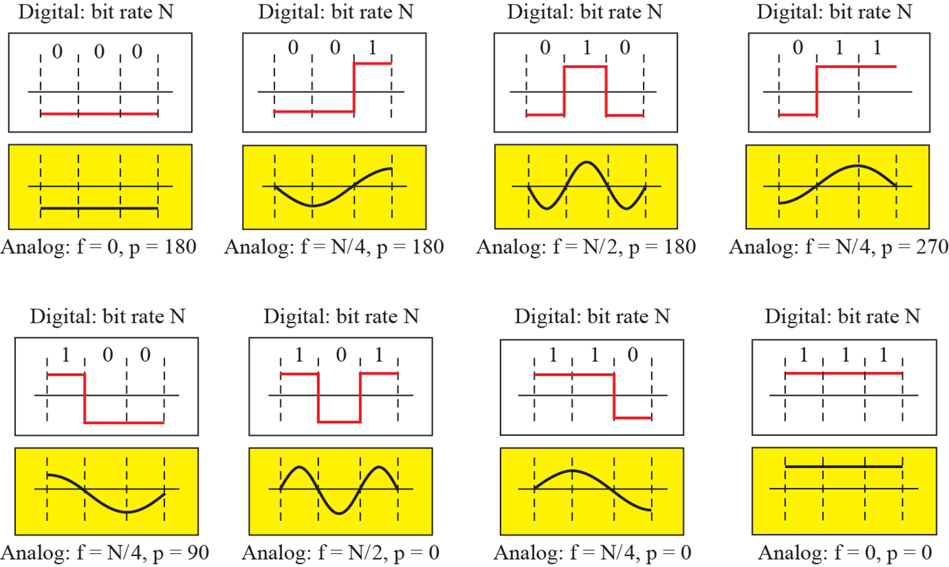


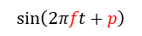
Bandwidth Rough bandwidth approximation of a digital Signal
1/N
270
$$\sin\left(2πft+p\right)$$
T=4/N
T=2/N
T=4/N
90

Slide 15
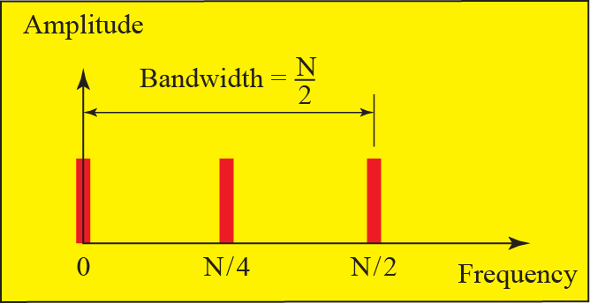
Bandwidth Rough bandwidth approximation of a digital Signal

Slide 16
Fourier analysis and Fourier Transform
Composite Signal
Signal mapping between time domain and frequency domain

Slide 17
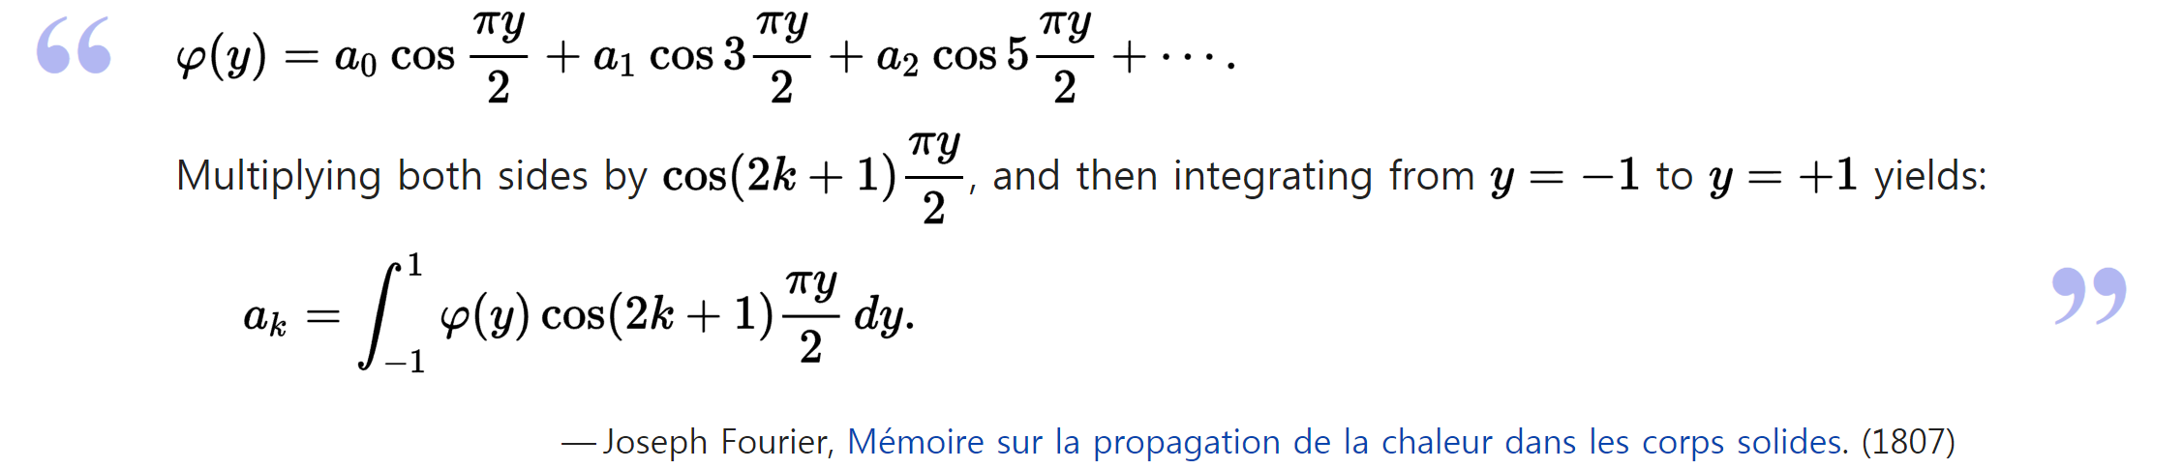
Fourier analysis
Jean-Baptiste Joseph Fourier (1768–1830)
French mathematician and physicist
An arbitrary (continuous) function can be represented by a trigonometric series

Slide 18
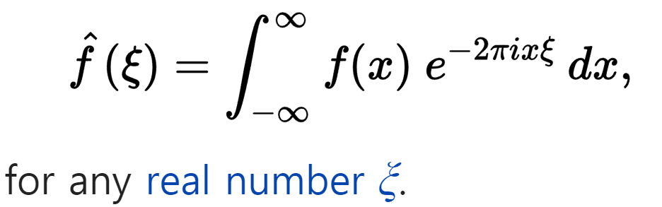
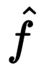
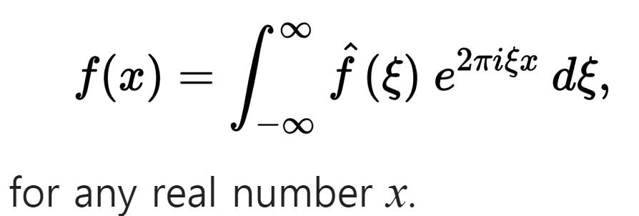
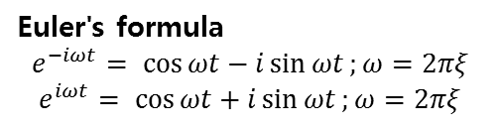
Fourier Transform
the Fourier transform of an integrable function f : ℝ → ℂ
When the independent variable x represents time (with SI unit of seconds), the transform variable ξ represents frequency (in hertz).
Under suitable conditions, f is determined by via the inverse transform:
Euler's formula
$$e^{−iωt}= \cos{ωt}−i\sin{ωt};ω=2πξ$$
$$e^{iωt}= \cos{ωt}+i\sin{ωt};ω=2πξ$$
International System of Units (abbreviated SI)
Xi (uppercase Ξ, lowercase ξ ) /zaɪ/ or /saɪ/

Slide 19
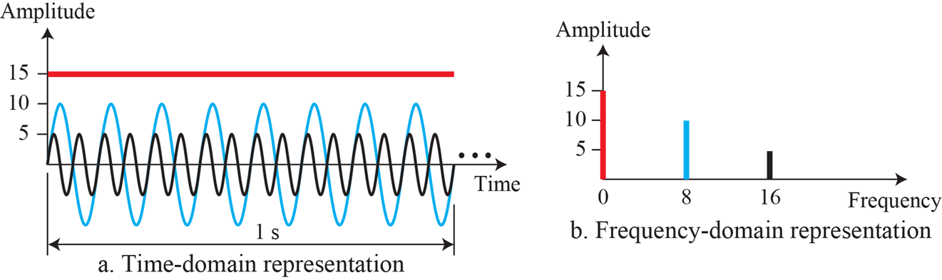
Frequency Domain
The frequency domain is more compact and useful when we are dealing with more than one sine wave

Slide 20
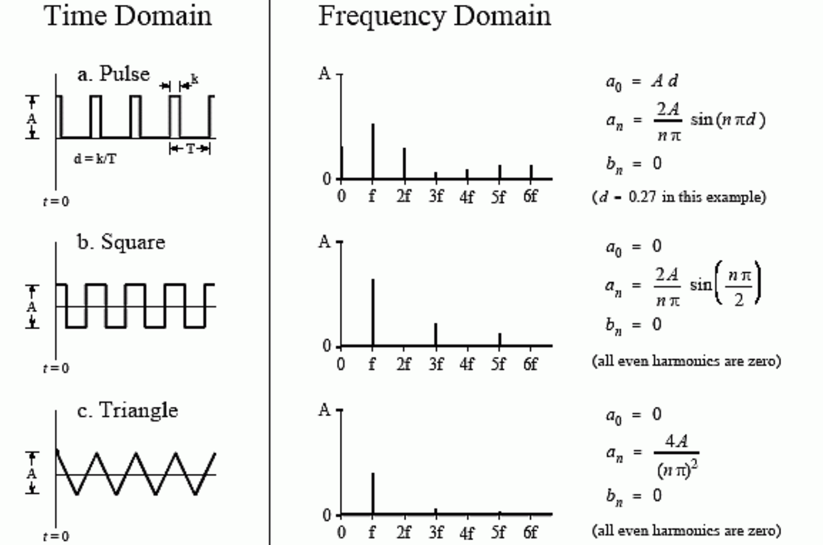
Fourier Transform

Slide 21
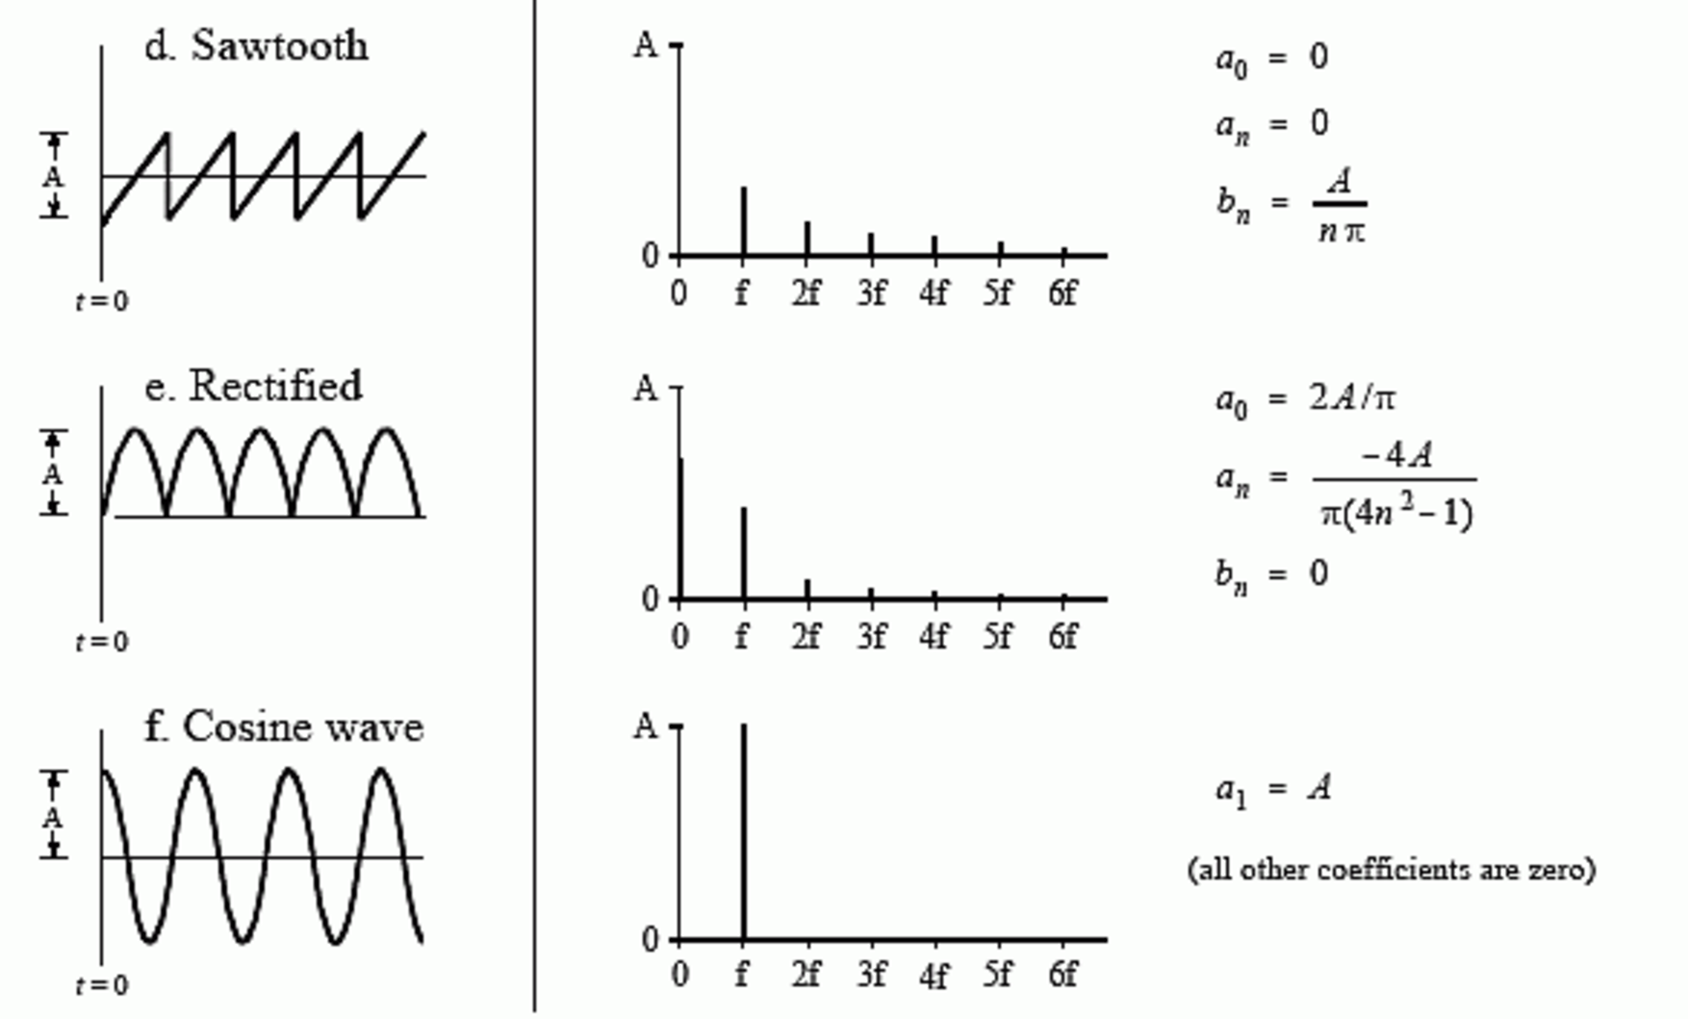
Fourier Transform

Slide 22
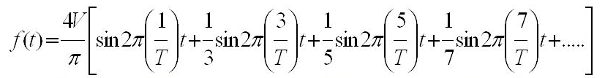
Fourier Transform
An arbitrary (continuous) function = analog signal or square wave
Fourier series of square wave
Voltage as a function of time
fundamental frequency (f₀=1/T)
the lowest frequency of a periodic waveform

Slide 23
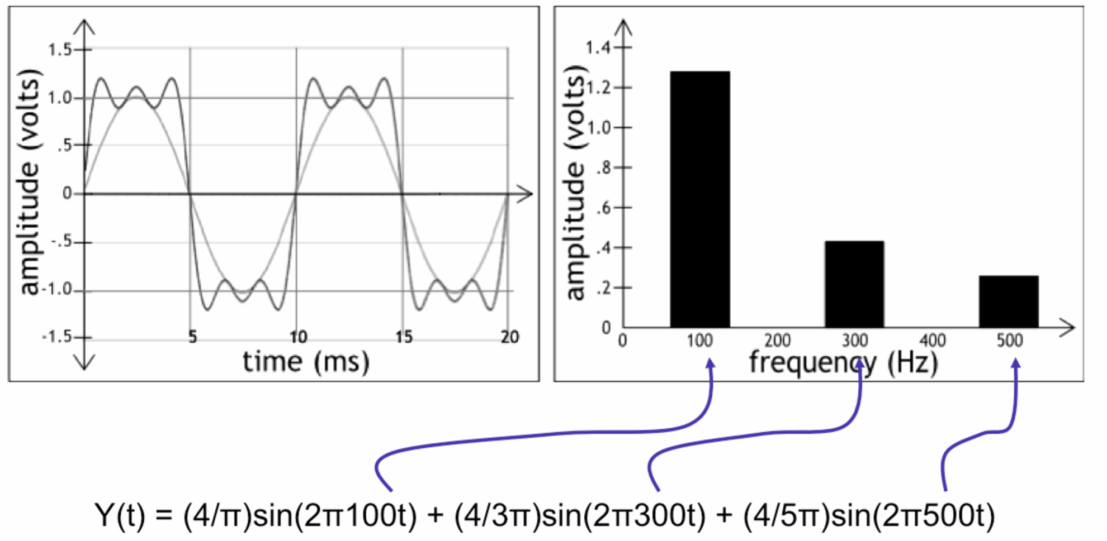
Fourier Transform

Slide 24
Channel Capacity

Slide 25
Channel Capacity
Maximum rate at which data can be transmitted over a given communications channel under given conditions
Bandwidth (Hz = cycles per second):
The bandwidth of the transmitted signal as constrained by the transmitter and the nature of the transmission medium
Noise: The average level of noise over the communications path

Slide 26
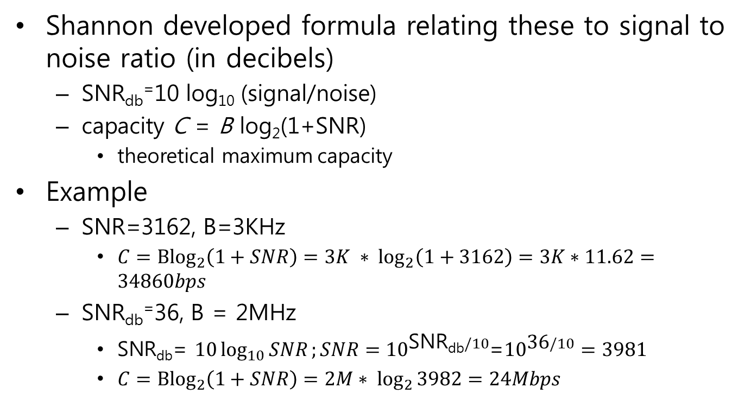
Channel Capacity Shannon Capacity Formula
Shannon developed formula relating these to signal to noise ratio (in decibels)
SNR_{db}⁼10 log₁₀ (signal/noise)
capacity C = B log₂(1+SNR)
theoretical maximum capacity
Example
SNR=3162, B=3KHz
$C={Blog}_{2}\left(1+SNR\right)=3K ∗ \log_{2}\left(1+3162\right)=3K∗11.62=34860bps$
SNR_{db}⁼36, B = 2MHz
$\text{SNR}\text{db}$= $10\log_{10}{SNR};SNR={10}^{\text{SNR}\text{db}/10}$=${10}^{\text{36}/10}=3981$
$C={Blog}_{2}\left(1+SNR\right)=2M∗ \log_{2}{3982}=24Mbps$

Slide 27
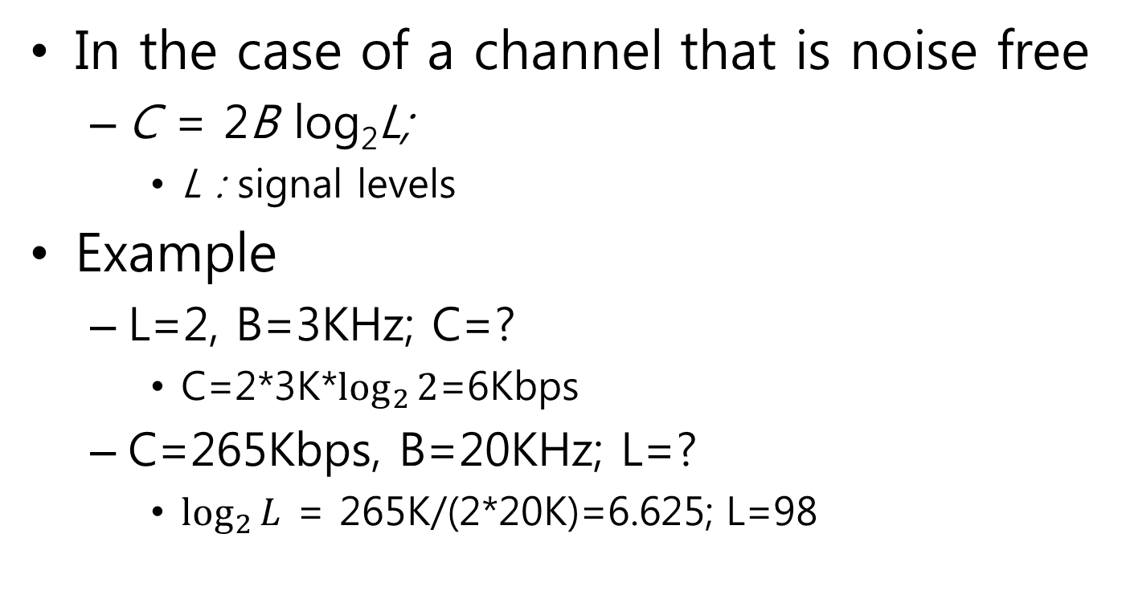
Channel Capacity Nyquist Bandwidth
In the case of a channel that is noise free
C = 2B log₂L;
L : signal levels
Example
L=2, B=3KHz; C=?
C=2*3K*$\log_{2}{2}$=6Kbps
C=265Kbps, B=20KHz; L=?
$\log_{2}{L}$ = 265K/(2*20K)=6.625; L=98

Slide 28
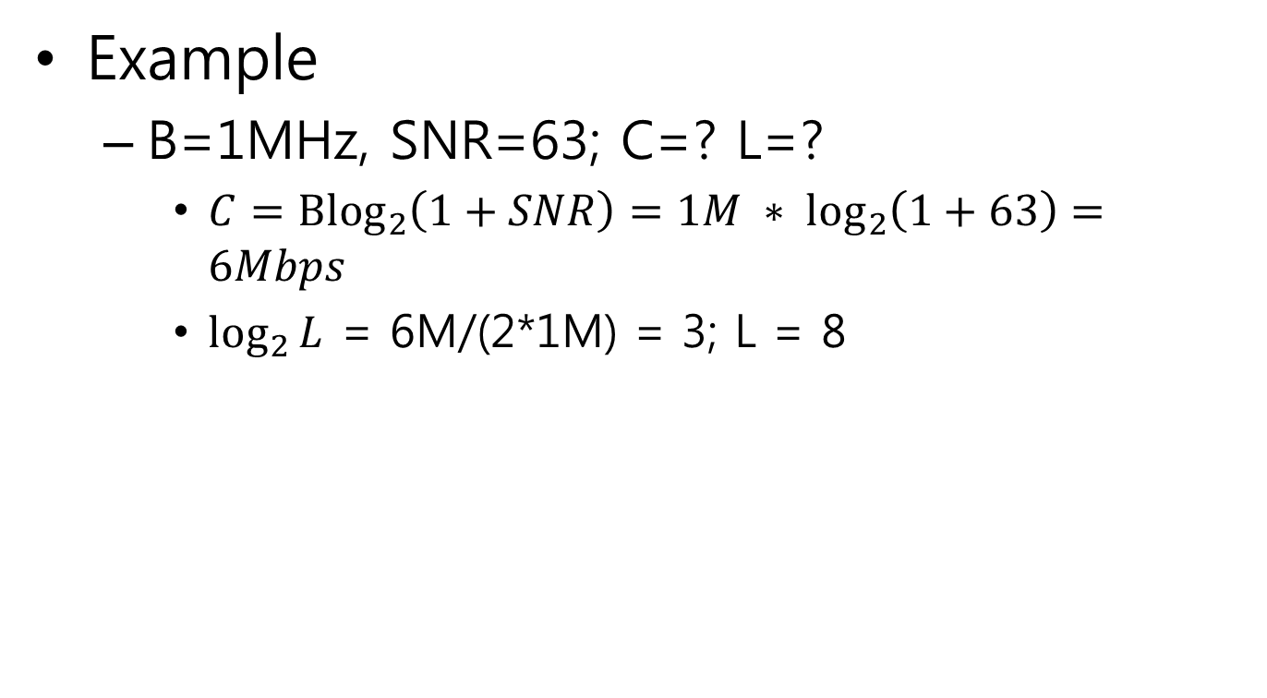
Channel Capacity
Example
B=1MHz, SNR=63; C=? L=?
$C={Blog}_{2}\left(1+SNR\right)=1M ∗ \log_{2}\left(1+63\right)=6Mbps$
$\log_{2}{L}$ = 6M/(2*1M) = 3; L = 8

Slide 29
Digital Data to Digital Signal
Digital Signal Encoding
1. Line coding

Slide 30
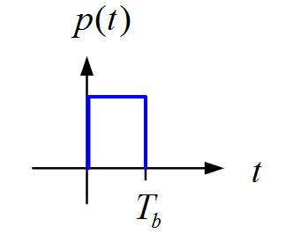
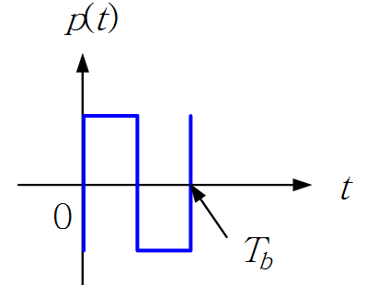
Digital Signaling Line Coding
Line coding is the process of converting digital data to digital signals
converting a sequence of bits to a sequence of symbols
p(t) : Pulse Shape
Digital
Data
Physical
Waveform
Line Coder

Slide 31
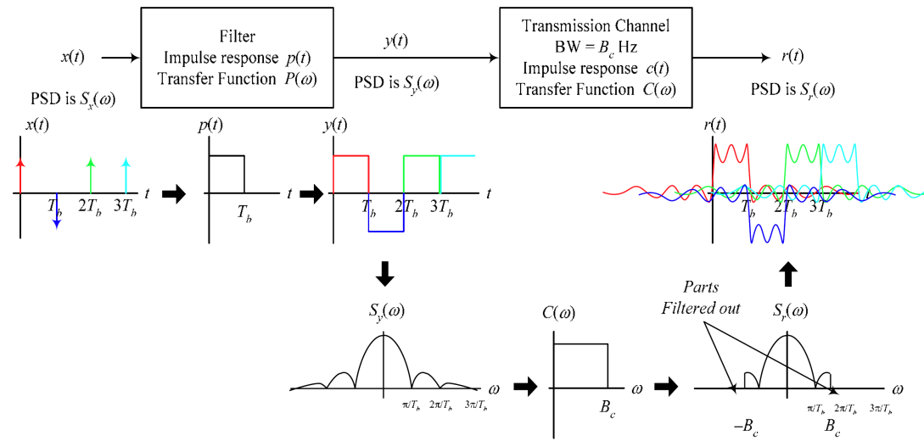
Line Coding Nyquist Criterion for Zero–ISI (Inter-Symbol Interference)
power spectral density (PSD)

Slide 32
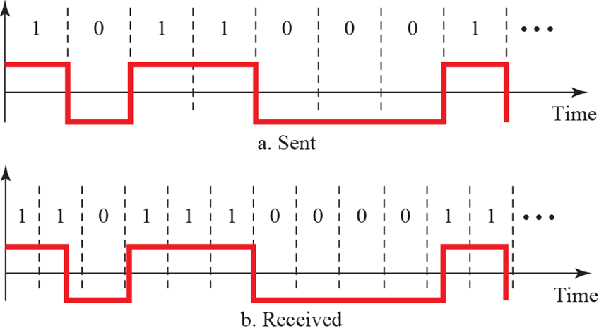
Line Encoding Clocking : Bit synchronization
Bit synchronization between the sender and the receiver
timing of bits - when they start and end

Slide 33
Line coding Clocking : Bit synchronization
For reliable clock recovery at the receiver, one usually imposes a maximum run length constraint on the generated channel sequence
the maximum number of consecutive ones or zeros is bounded to a reasonable number

Slide 34
Line Encoding DC component
DC component : the average voltage over a given interval
Long term interval
Short term interval
Causes for non-zero DC component
Signal polarity
Disparity of a bit pattern : the difference between the number of transmitted zeros and the number of transmitted ones
Running disparity : the running total of the disparity of all previously transmitted bits

Slide 35
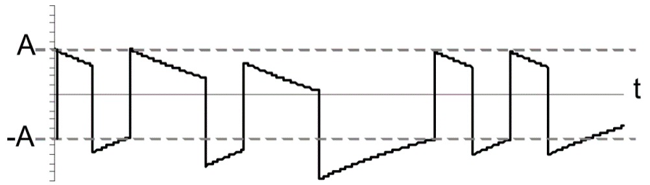
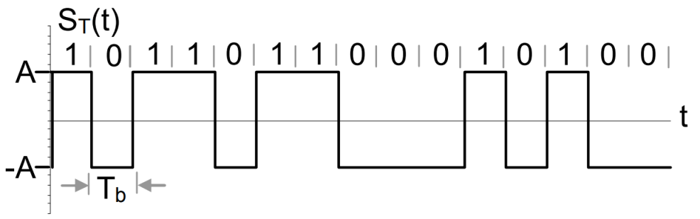
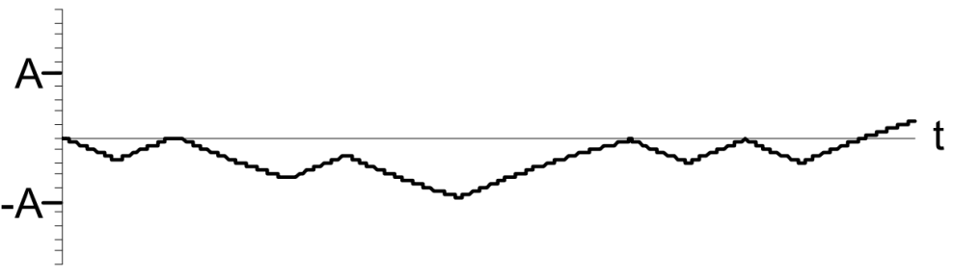
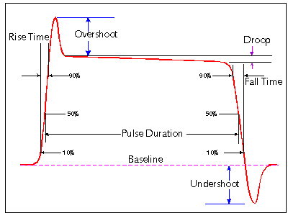
Line Encoding Baseline Wander
Since the data is random, the average voltage over a given observation interval will tend to vary with time, causing the base-line to drift randomly
Transmitted signal $S_{y}(t)$
Received signal$S_{r}(t)$
Baseline wander W(t)
Signal Droop

Slide 36
Line Encoding Bits per symbol
Data element (Unit of Data) :
Bit; bps (bits per second)
Signal element (Unit of Signal) :
Symbol; baud (symbols per second)
Signal bandwidth

Slide 37
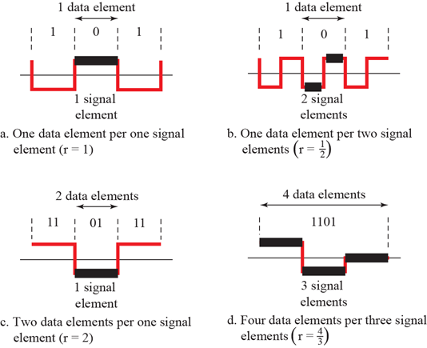
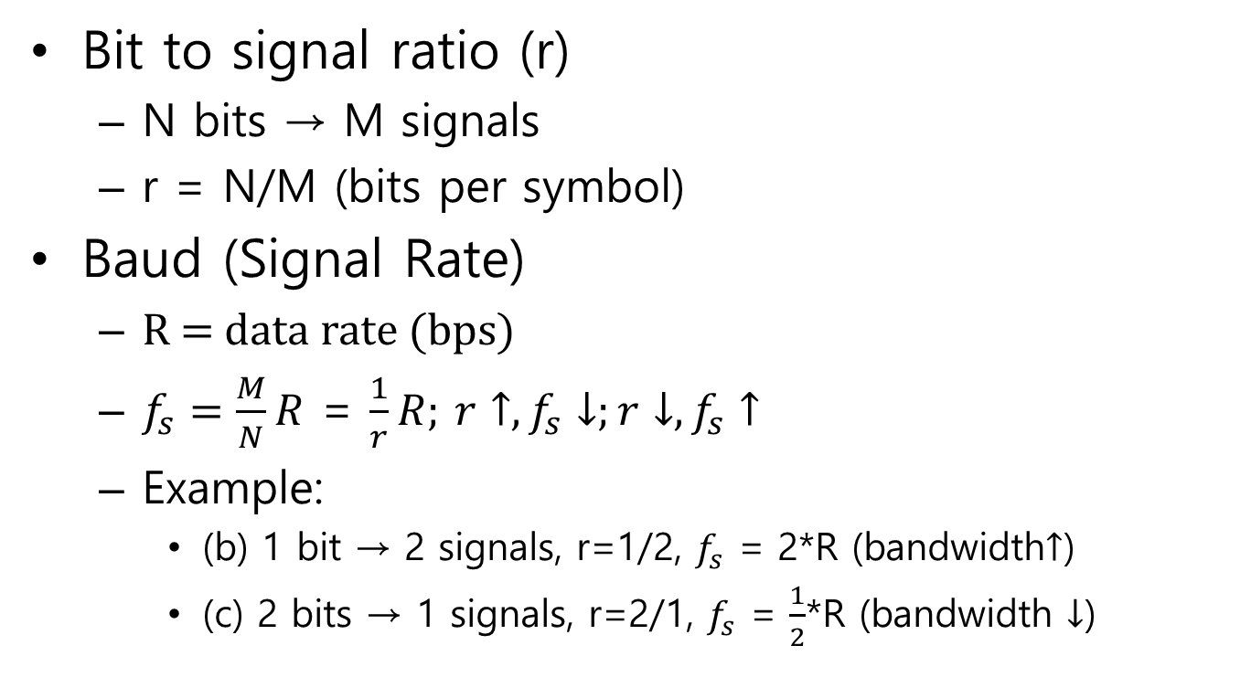
Line coding Bits per symbol
Bit to signal ratio (r)
N bits → M signals
r = N/M (bits per symbol)
Baud (Signal Rate)
R = data rate (bps)
$f_{s}=\frac{M}{N}R$ = $\frac{1}{r}R;$ $r↑, f_{s}↓;r↓, f_{s}↑$
Example:
(b) 1 bit → 2 signals, r=1/2, $f_{s}$ = 2*R (bandwidth$↑$)
(c) 2 bits → 1 signals, r=2/1, $f_{s}$ = $\frac{1}{2}$*R (bandwidth $↓$)

Slide 38
Line coding Good line coding criteria
Minimize transmission hardware
Facilitate (bit) synchronization
Minimize bandwidth
Eliminate a dc component (long term dc effect)
Minimize baseline wandering (short term dc effect)
Transparency
Any arbitrary symbol pattern can be transmitted and received
Ease error detection and correction
Lower Bit Error Rate (BER) performance
Signal level : two-level coding schemes have better BER than three-level coding schemes

Slide 39
Line Encoding Power Spectrum Density (PSD)
The power spectrum density of a line code describes the distribution of power into frequency components composing that signal
A digital signal is a composite analog signal with infinite bandwidth
The power spectral density (PSD) refers to the spectral energy distribution that would be found per unit time, since the total energy of such a signal over all time would generally be infinite

Slide 40
Line Encoding Power Spectrum Density
PSD
DC component (long term DC effect)
A spike at 0 Hz
Baseline Wander (short term dc effect)
High PSD at low frequency (or 0 Hz)
Bandwidth (Baud)

Slide 41
Line coding mapping concept
Data only : {1,0}
Data + Clock : {1,0} + clock signal
Clock signal : transition in the bit period

Slide 42
Line coding mapping concept
Signal :
Amplitude : {high-level, low level}
Polarity
{1,0} : Unipolar {+V,0} , Polar {+V, -V } , bipolar {$±$V, 0}
Alteration of amplitude
Alternative Mark Inverted (AMI) {mark($±$V), 0}
The number of Ones transmitted : even (+V), odd(-V)
Bit error detection
Transition of amplitude
Differential coding
the beginning of the bit period : { transition, non-transition}
the middle of the bit period : { down transition, up transition }

Slide 43
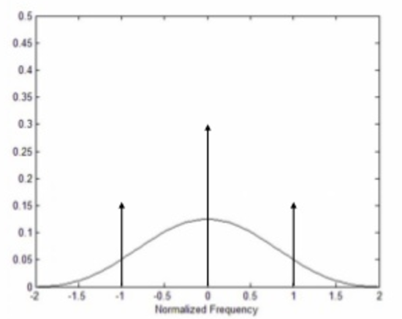
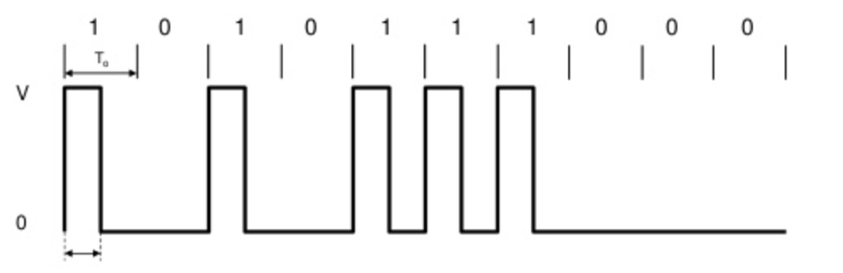
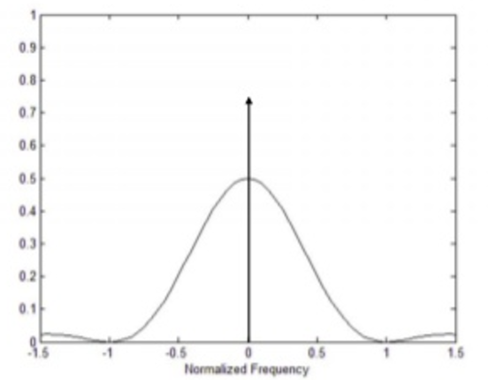
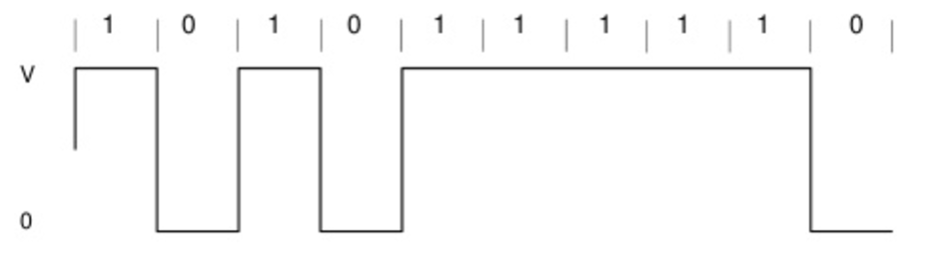
Line coding Unipolar RZ and NRZ
Power Signal Density (PSD)
Return to Zero (RZ)
Non Return to Zero (NRZ)
clocking
DC component
r = ½, Baud=2N
Baseline wander
No clocking
DC component
R=1, Baud=N
No transparency : 0000… or 111111 and no error detection

Slide 44
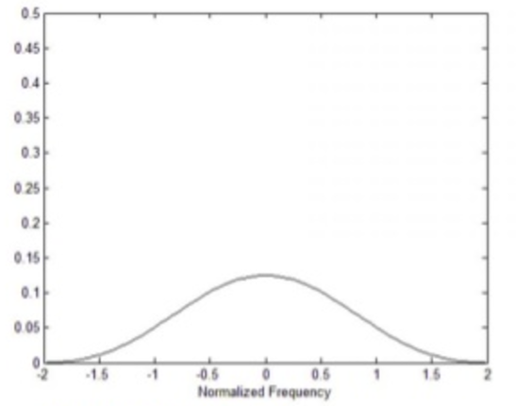
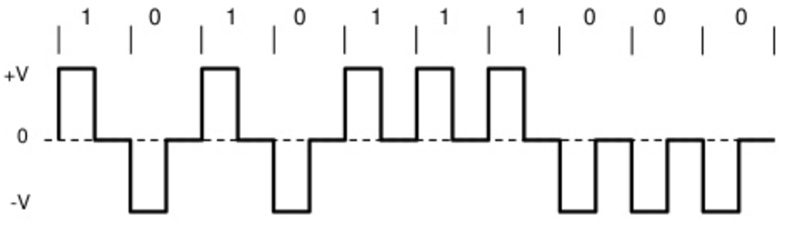
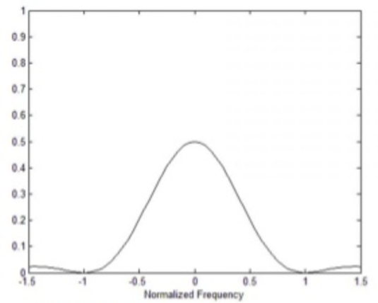
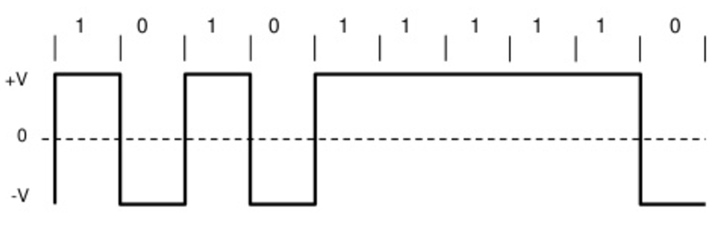
Line coding Polar RZ and NRZ
Power Signal Density (PSD)
Polar RZ
Polar NRZ (NRZ-L)
No DC component
r = ½, Baud=2N
clocking
Baseline wander
No DC component
R=1, Baud=N
No clocking
No transparency : 0000… or 111111 and no error detection

Slide 45
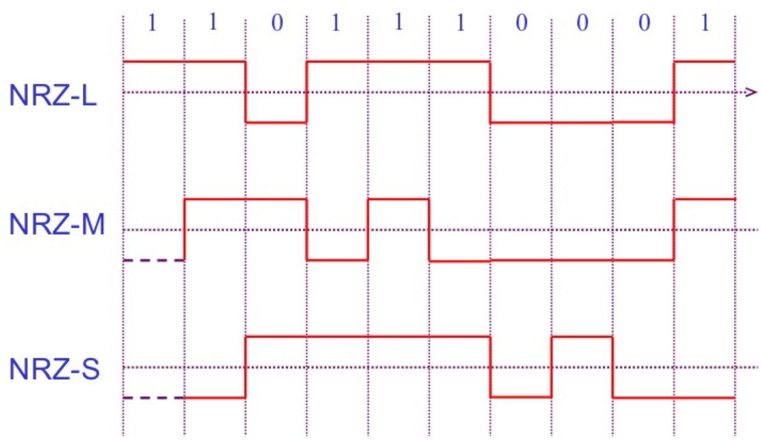
Line coding Polar RZ and NRZ
Polar NRZ-M (NRZ-I) and Polar NRZ-S
NRZ-L (Level)
NRZ-M (mark)
NRZ-S (Space)
1 forces a transition 0 does nothing (keeps sending the previous level)
1 does nothing (keeps sending the previous level) 0 forces a transition

Slide 46
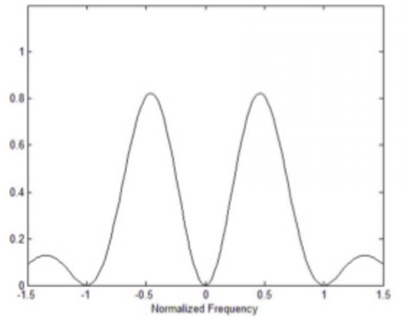
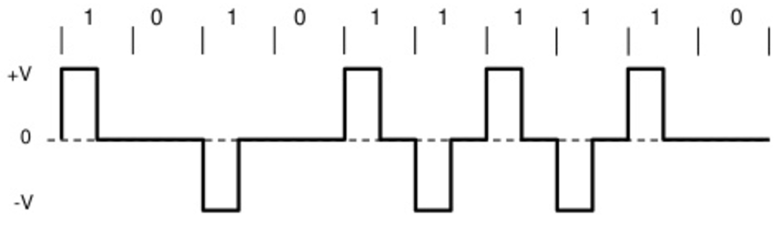
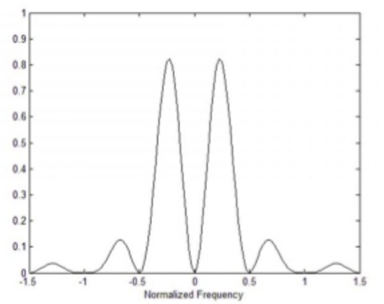
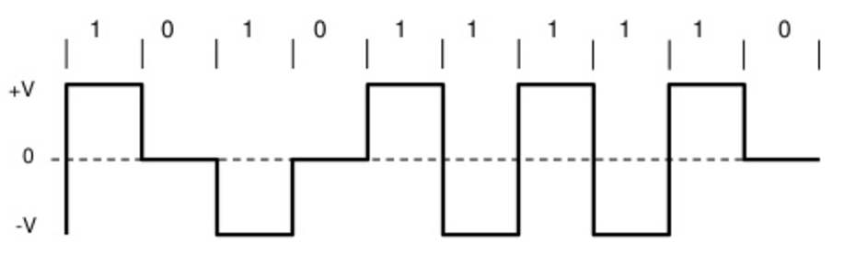
Line coding Bipolar RZ and NRZ
Alternative Mark Inverted (AMI) {mark($±$V), 0}
Power Signal Density (PSD)
Bipolar RZ (RZ-AMI)
Bipolar NRZ (NRZ-AMI)
clocking
No DC component
r = ½, Baud=2N
No DC component
R=1, Baud=N
No clocking
Not transparent : 0000… and single bit error detection

Slide 47
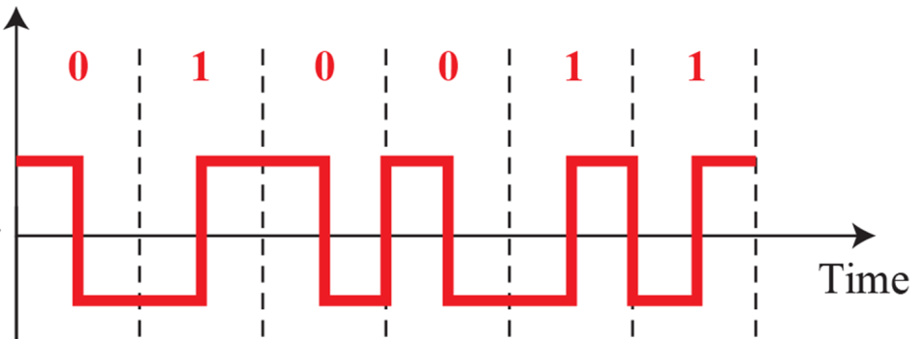



Line coding Manchester encoding
Manchester encoding (Polar Biphase-L)
Differential Manchester encoding
Example
https://en.wikipedia.org/wiki/Line_code
OR
Two consecutive bits of the same type force a transition at the beginning of a bit period. 0 forces a negative transition in the middle of the bit 1 forces a positive transition in the middle of the bit
1 forces a negative transition in the middle of the bit 0 forces a positive transition in the middle of the bit
R=1/2, Baud=2N
No DC component
Transparent
No error detection
1 keeps level constant 0 forces a transition
A transition in the middle of the bit

Slide 48


Line coding BER : two-level & three-level line coding
dB = 10*$\log_{10}{(\frac{P_{1}}{P_{2}})}$
3dB=10*$\log_{10}\left(\frac{P_{1}}{P_{2}}\right)=\text{10∗}\log_{10}\left(\frac{{2P}_{2}}{P_{2}}\right)$
$\frac{3}{10}=$ $\log_{10}\left(\frac{P_{1}}{P_{2}}\right)$
$\frac{P_{1}}{P_{2}}$ = ${10}^{\frac{3}{10}}={10}^{0.3}$=1.995
$P_{1}$ $≒$ 2$P_{2}$
E_{b}/N₀ (SNR per bit)
energy per bit to noise power spectral density ratio
a normalized signal-to-noise ratio (SNR) measure
when comparing the bit error rate (BER) performance of different digital modulation schemes without taking bandwidth into account

Slide 49
Digital Data to Digital Signal
Digital Signal Encoding
2. Multilevel Coding

Slide 50

Multilevel Coding 2B1Q
2B1Q
2 bits are mapped to a single signal having 4 states {-3, -1, +1, +3}
2B1Q Table (Gray code)
00 -3
01 -1
+1
10 +3

Slide 51


Multilevel Coding 8B6T
8B6T (243($3^{5}$)<256($2^{8}$)<729($3^{6}$) states)
8 bits are mapped into 6 signal symbols using the mapping table
Each symbol has three states {-V,0,+V}
100BASE-T4 (obsoleted) used 8B6T

Slide 52


Multilevel Coding MLT-3 encoding
MLT-3 cycles sequentially through the voltage levels −1, 0, +1, 0.
It moves to the next state to transmit a 1 bit, and stays in the same state to transmit a 0 bit
MLT-3: Multi-Level Transmit

Slide 53

Multilevel Coding 4D-PAM5 (Ethernet 1Gb/s)
Four dimensional five-level pulse amplitude modulation (PAM)
Signal level : { -2, -1, 0, +1, +2 }
X = {-1, +1}, Y= { -2, 0, +2 }
2x2x2x2+3x3x3x3
=16+81=97
{-2,-1,0,+1,+2}
{X, Y}
{-2,-1,0,+1,+2}
{X, Y}
{-2,-1,0,+1,+2}
{X, Y}
{-2,-1,0,+1,+2}
{X, Y}
States = 5x5x5x5 = 625
Subsets = 2x2x2x2 = 16
625 states are grouped into 16 subsets. (16 = 2x2x2x2)
16 subsets are grouped into 8 subsets again.
Each subsets chooses 64 states (8*64=512=2^9)
2x3x2x2+3x2x3x3
=24+54=78

Slide 54

Multilevel Coding 4D-PAM5 (Ethernet 1Gb/s)
The combined output of all four transmitters on each line forms a four-dimensional constellation.
the possible outputs of each transmitter as an axis orthogonal (at right angles (${90}^{o}$) to the other axis.
https://www.iol.unh.edu/sites/default/files/knowledgebase/ge/pcs.pdf

Slide 55

Multilevel Coding 4D-PAM5 (Ethernet 1Gb/s)
For every symbol period, one point in the constellation is sent.
While the real system is a 5x5x5x5 constellation,
A simple 5x5 constellation is easier to explain…
Line 1 (+1)
Line 3 (+2)
Line 2
Line 4
(-2)
(-1)

Slide 56
Multilevel Coding 4D-PAM5 (Ethernet 1Gb/s)
However, noise affects the constellation.
If too much noise disrupts the signaling, then the receiver will not be able to distinguish between the correct point in the constellation and neighboring (incorrect) points in the constellation.
Attenuation also affects the constellation, with similar concerns.
https://www.iol.unh.edu/sites/default/files/knowledgebase/ge/pcs.pdf

Slide 57



Multilevel Coding 4D-PAM5 (Ethernet 1Gb/s)
Increasing Symbol Distance
To combat this problem, limit the permissible combination of symbols.
The separation of “even” and “odd” points has the effect of increasing the minimum distance between the permissible transmit codes.
The minimum squared distance = ${\left(\sqrt{2}\right)}^{2}$= 2
1
2
$$\sqrt{2}$$
https://www.iol.unh.edu/sites/default/files/knowledgebase/ge/pcs.pdf

Slide 58

Multilevel Coding 4D-PAM5 (Ethernet 1Gb/s)
It can be shown that the minimum squared distance between any two points in a sublattice (a subset) is at least 4.
Example
D4: XYYX + YXXY
Pick +1(X),-2 (Y),+2 (Y),-1 (X) and 0 (Y),-1(X),+1(X),0 (Y)
The minimum squared distance:
${\left(+1−0\right)}^{2}+{\left(−2−(−1)\right)}^{2}+{\left(+2−(+1)\right)}^{2}+{\left(−1−0\right)}^{2}$= 1+1+1+1=4
D0: XXXX + YYYY
Pick -2, -2, 0, -2 and 0,0,-2,0
The minimum squared distance:
${\left(−2\right)}^{2}+{\left(−2\right)}^{2}+{\left(−2\right)}^{2}{+\left(−2\right)}^{2}=4×4=16$
https://www.iol.unh.edu/sites/default/files/knowledgebase/ge/pcs.pdf

Slide 59




Multilevel Coding 4D-PAM5 (Ethernet 1Gb/s) Trellis Encoder
Point selector within the subset
($2^{6}$= 64)
Subset
Selector
($2^{3}$= 8)
Encoder: Trellis-Coded Modulation [TCM] (a kind of BCC)
Decoder: Viterbi Algorithm

Slide 60

Multilevel Coding 4D-PAM5 (Ethernet 1Gb/s) The 1000BASE-T Convolutional Encoder
Enabled(1)
IEEE 802.3-2022 40.3.1.3.4 Generation of bits Sdn[8:0]
- The figure taken from the reference
https://www.iol.unh.edu/sites/default/files/knowledgebase/ge/pcs.pdf

Slide 61


Multilevel Coding 4D-PAM5 (Ethernet 1Gb/s) The Trellis Structure of the encoder
CSn[0..2]
Sdn[6..7]=00
Before
CSn[0..2]=000
Input: Sdn[6..7] = 01
CSn[1] = CSn[0]$⊕$Sdn[6]= $0⊕0$=0
CSn[2] = CSn[1]$⊕$Sdn[7]= $0⊕1$=1
After
CSn[0..2]=001
Sdn[6..7]=01
Sdn[6..7]=10
Sdn[6..7]=11
https://www.iol.unh.edu/sites/default/files/knowledgebase/ge/pcs.pdf

Slide 62


Multilevel Coding 4D-PAM5 (Ethernet 1Gb/s)
IEEE 802.3-2022 Table 40–1—Bit-to-symbol mapping (even subsets)

Slide 63

Multilevel Coding 4D-PAM5 (Ethernet 1Gb/s)
Code (2’s complements)
010 (+2)
001 (+1)
000 (0)
111 (-1)
110 (-2)
Coded output
(-2,-2,-2,+2)→(110 110 110 010)
IEEE 802.3-2022 Table 40–1—Bit-to-symbol mapping (even subsets) (continued)

Slide 64




Multilevel Coding 4D-PAM5 (Ethernet 1Gb/s)
512 ($2^{9}$) states = sd[6..8] x sd[0..5]= 8 x 64 = ($2^{3}$) subgroups x ($2^{6}$) points
Each state is represented by 12bits (4*3bits): 9bits→12bits
– Only 512 valid codes among 4096 codes
256 states
m=8bits
m+r=8bits+1bit
r=TCM bit (parity)
Pn= 4*(3bits); 3bits for PAM5
- 3bits indicates one of { -2, -1, 0, +1, +2 }
4 channels (125Mbaud) = 4 X 125Mbaud
$$\tilde{m}+\tilde{r}$$
$$\tilde{P_{n}}$$
8bits←(Viterbi Decoder)←9bits←(Constellation Demapper) ←12bits
Each selected point (12bits) is mapped to four 3 bits outputs for four wire
R=1Gbps, r=8bits per 4symbols= 2bits per 1symbol per channel,
$f_{s} (per channel)=\frac{1}{2}∗256Mbps=125Mbaud$; 1000BASE-T (1GBASE-T)

Slide 65
Input Data Randomization
1. Scrambling

Slide 66
Input Data Conversion
Problem
Transparency
Any arbitrary symbol pattern can be transmitted and received
00000000….. or 11111111….
DC component
Long term Disparity (Running disparity)
Baseline wander
Short term Disparity
Solution
Input data conversion or randomization
Running Disparity (RD) to be (near) zero
the running total of the disparity of all previously transmitted bits
The difference between the number of Ones and the number of Zeros in a data
Distribution of Ones and Zeros to be even

Slide 67
Input Data Conversion
Code Mapping
Block Code : m-to-n bits mapping
Substitution of pre-defined input pattern
Replacing continuous zeros (8/4) to pre-defined pattern
Scrambling
Pseudo-random generator
a linear feedback shift register (LFSR)
An LFSR of ‘n’ elements will identically repeat its output every $2^{n}$-1 outputs

Slide 68

Code Mapping : Block Coding
Block coding
adding the redundancy to ensure synchronization and to provide some kind of inherent error detecting

Slide 69

Input Data Conversion Block Coding : 4B5B
4B5B maps groups of 4 bits (quadbits) onto groups of 5 bits, with a minimum density of 1 bits in the output
each block of 4 consecutive bits an equivalent word of 5 bits
5 bit words are pre-determined in a dictionary and
they are chosen to ensure that there will be at least two transitions per block of bits

Slide 70

Block Coding
4B5B encoder with NRZ-I (Polar NZR-M) line coder
100BASE-TX

Slide 71
Input Data Conversion Block Coding : 8B10B
8b/10b maps 8-bit words to 10-bit symbols to achieve DC-balance and bounded disparity, and yet provide enough state changes to allow reasonable clock recovery
the difference between the counts of ones and zeros in a string of at least 20 bits is no more than two, and
there are not more than five ones or zeros in a row

Slide 72



Input Data Conversion Block Coding : 8B10B
HGF
3B/4B
jhgf
6B/4B = N[1]-N[0] = $±$2,0
- 6B: 00+1111, 0000+11, 000+111
- 4B: 0+111,000+1, 00+11
Initial RD (Running Disparity) = -1
EDCBA
5B/6B
iedcba

Slide 73
Substitution of pre-defined input pattern
Replacing continuous zeros (8/4) to pre-defined pattern

Slide 74
Input Data Conversion Substitution of pre-defined input pattern
Replacing pre-defined input bits to another input bits having the same length
no dc component
no long sequences of zero level line signal
no reduction in data rate
error detection capability

Slide 75

Modified AMI code : B8ZS
Bipolar NRZ (NRZ-AMI)
bipolar with eight-zero substitution (B8ZS)
replacing each string of 8 consecutive zeros with the special pattern "000VB0VB“
the polarity of the preceding mark (1)
Positive(+) : 000+−0−+
Negative(-) : 000−+0+−

Slide 76


Modified AMI code : HDB3
high density bipolar of order 3 (HDB3)
replacing any instance of 4 consecutive 0 bits with one of the patterns "000V" or "B00V"

Slide 77

Modified AMI code : HDB3

Slide 78

Scrambling
Input XOR with Pseudo-Random bit strings
In XOR PR = Out; 1010 XOR 1100 = 0110
Out XOR PR = IN; 0110 XOR 1100 = 1010

Slide 79
Input Data Conversion Scrambling
Input data is randomized by XOR with input data and the output of a pseudo-random generator
Pseudo-random generator
a linear feedback shift register (LFSR)
An LFSR of ‘n’ elements will identically repeat its output every $2^{n}$-1 outputs

Slide 80


Scrambling a linear feedback shift register (LFSR)
TTT:111: Output:0
TTT:011: OutPut:0
TTT:001: OutPut:1
TTT:100: OutPut:0
TTT:010: Output:1
TTT:101: Output:1
TTT:110: OutPut:1
-------------------------
TTT:111: Output:0
The repeating 7-code ($2^{3}−1$) pattern for this LFSR (n=3)
(TTT:111) 0010111

Slide 81

Scrambling Example
(1111) 1
(0111) 1
(1011) 1
(0101) 1
(1010) 0
(1101) 1
(0110) 0
(0011) 1
(1001) 1
(0100) 0
(0010) 0
(0001) 1
(1000) 0
(1100) 0
(1110) 0
(1111)

Slide 82

Scrambling 1000BASE-T Scramblers
Auto-Negotiation in Physical Control
$2^{33}$-1 (8589934591) bits before the LFSR pattern repeats (68.72s)

Slide 83
Digital Data to Analog Signal
Digital Modulation (Shit Key)

Slide 84
Signaling Scheme Basic Concepts : Sine Wave
$s\left(t\right)=A \sin{(2πf_{0}t}+∅)=A\sin{(ω_{0}t}+∅)=A cos⁡(ω_{0}t+∅)$; $ω_{0}=\frac{2π}{T_{0}}$
peak amplitude (A)
Amplitude Shift Key
frequency (f)
Frequency Shit Key
phase (φ)
Phase Shift Key
peak amplitude (A) + phase (φ)
Quadrature Amplitude Modulation (QAM)
frequency (f) + phase (φ)
Minimal Shift Key (MSK)

Slide 85

Signaling Scheme Basic Concepts

Slide 86


Signaling Scheme Basic Concepts : Orthogonal functions
Periodic Functions
f(x+T)=f(x) for all X; T = Period of f(x)
$\sin{(ωt}$) and $\cos{(ωt)}$ with T = ${2π}/ω$
f and g are both periodic functions with period T
f+g & fg are periodic
Even and Odd Functions
Even function : f(-x)=f(x); cos(x)
$\int_{−L}^{L}{f\left(x\right)dx}=2\int_{0}^{L}{f\left(x\right)dx}$
Odd function : f(-x)=-f(x); sin(x)
$\int_{−L}^{L}{f\left(x\right)dx}=0$

Slide 87
Signaling Scheme Basic Concepts : Orthogonal functions
Orthogonal Functions
Two non-zero functions are orthogonal on a $≤$ x $≤$ b if $\int_{a}^{b}{f\left(x\right)g\left(x\right)dx}=0$
the integral of the product of functions over the interval
A set of non-zero functions are mutually orthogonal on a $≤$ x $≤$ b if
$\int_{a}^{b}{f_{i}\left(x\right)f_{j}\left(x\right)dx}=\left\{\begin{aligned}0, i≠j \\ c \left(>0\right), i=j\end{aligned}\right.$

Slide 88


Signaling Scheme Basic Concepts : Orthogonal functions
See http://tutorial.math.lamar.edu/Classes/DE/PeriodicOrthogonal.aspx for proof

Slide 89



Signaling Scheme Basic Concepts : Euler's formula
Euler's formula
the fundamental relationship between the trigonometric functions and the complex exponential function
$e^{iωt}=\cos{ωt}+i\sin{ωt}$
Euler's Identity : $e^{iπ}$+1 = 0
$$even:\cos\left(−x\right)=cos\left(x\right)$$
$$odd:\sin\left(−x\right)={−\sin\left(x\right)}$$
$$e^{−ix}=\cos\left(−x\right)+i\sin\left(−x\right)$$
= $\cos\left(x\right)−i\sin\left(x\right)$
-$e^{−ix}=−\cos\left(x\right)+i\sin\left(x\right)$
https://www.youtube.com/watch?v=BH0snUYPQEM

Slide 90


Signaling Scheme Basic Concepts : Euler's formula
Relationship to trigonometry
an interpretation of the sine and cosine functions as weighted sums of the exponential function

Slide 91

Amplitude Sift Key (ASK) Binary ASK : On-Off keying (OOK)
the amplitude of the carrier signal is varied to create signal elements.
Both frequency and phase remain constant

Slide 92






Amplitude Sift Key (ASK) Demodulation
$$A=\sqrt{\frac{2E_{b}}{T_{b}}}$$
$E_{b}:$energy per bit
$T_{b}$: bit duration
$A=\sqrt{\frac{2E_{b}}{T_{b}}}$
$\int_{0}^{T_{b}}{A\cos\left(ω_{c}t\right)∙A\cos\left(ω_{c}t\right)}dt= A^{2}∙\frac{T_{b}}{2}$ = $E_{b}$
$$\int_{0}^{T_{b}}{0∙\cos{{(ω}_{c}t)}}dt=0$$

Slide 93
Frequency Shift Key
The frequency of the modulated signal is constant for the duration of one signal element, but changes for the next signal element if the data element changes
Both peak amplitude and phase remain constant for all signal elements

Slide 94





Frequency Shift Key
$E_{b}:$energy per bit
$T_{b}$: bit duration
$A=\sqrt{\frac{2E_{b}}{T_{b}}}$
Coherent detection
$\int_{0}^{T_{b}}{A\cos\left(ω_{1}t\right)∙A\cos\left(ω_{1}t\right)}dt= A^{2}∙\frac{T_{b}}{2}$= $E_{b}$
$$\int_{0}^{T_{b}}{A\cos\left(ω_{1}t\right)∙A\cos\left(ω_{2}t\right)}dt=0$$
If $ω_{2}={nω}_{1}, (ω_{1}=\frac{2π}{T_{b}}),$

Slide 95

Phase Shift Key (PSK)
the phase of the carrier is varied to represent two or more different signal elements

Slide 96



Phase Shift Key (PSK) Binary PSK (BPSK)
$E_{b}:$energy per bit
$T_{b}$: bit duration
$A=\sqrt{\frac{2E_{b}}{T_{b}}}$
$$A=\sqrt{\frac{2E_{b}}{T_{b}}}$$
$ω_{c}=\frac{2π}{T_{c}}, f_{c}=\frac{1}{T_{c}}$
$A^{2}∙\frac{T_{b}}{2}$ =$\frac{2E_{b}}{T_{b}}∙\frac{T_{b}}{2}$ = $E_{b}$
$\int_{0}^{T_{b}}{−A\cos{{(ω}_{c}t)∙A}\cos{{(ω}_{c}t)}}dt=−A^{2}∙\frac{T_{b}}{2}$ = - $E_{b}$
$\int_{0}^{T_{b}}{A\cos{{(ω}_{c}t)∙A}\cos{{(ω}_{c}t)}}dt= A^{2}∙\frac{T_{b}}{2}$ = $E_{b}$

Slide 97


Phase Shift Key (PSK) BPSK constellation diagram
$$\sin{(2πf_{c}t)}$$
$$\cos{(2πf_{c}t)}$$
$$\left\{\begin{aligned}0=−E_{b} \\ 1= { E}_{b}\end{aligned}\right.$$
$$E_{b}$$
BPSK Constellation

Slide 98

M-ary Signaling Scheme
M-ary Signaling Scheme
M states (symbol states)
The “off” states
M-1 discrete “on” states
Bit rate $N_{b}$bps (bit peiod: $T_{b}=1/{N_{b}}$)
Symbol rate $r_{s}$ (symbols per second)
$N_{b}=r_{s}\log_{2}{M}$; $r_{s}={r_{b}}/{\log_{2}{M}}$
Symbol period ($T_{s}$) = 1/$r_{s}$
Transmission Bandwidth ($B_{T}$Hz) $≈{r_{b}}/{\log_{2}{M}}$
Spectral Efficiency
${N_{b}}/{B_{T}}= \log_{2}{M}$ bps/Hz

Slide 99
M-ary Signaling Scheme Quadrature phase-shift keying (QPSK)
QPSK can encode two bits per symbol, shown in the diagram with Gray coding to minimize the bit error rate (BER)
QPSK can be used to double the data rate compared with a BPSK system while maintaining the same bandwidth of the signal

Slide 100


M-ary Signaling Scheme Quadrature phase-shift keying (QPSK)
When transmitting two signals by modulating them with QPSK(QAM), the transmitted signal will be of the form:
$$e^{i2πf_{0}t}=\cos{2πf_{0}t}+i\sin{2πf_{0}t}$$
$$\cos{(θ+\frac{π}{2})}=−\sin{(θ)}$$
Writing the symbols in the constellation diagram in terms of the sine and cosine waves used to transmit them:
$$s\left(t\right)=A\cos{(2π}f_{0}t+ϕ)$$

Slide 101






M-ary Signaling Scheme Quadrature phase-shift keying (QPSK)
$E_{b}:$energy per bit
$T_{b}$: bit duration
$A=\sqrt{\frac{2E_{b}}{T_{b}}}$
/$\sqrt{2}$
/$\sqrt{2}$
$$±\sqrt{\frac{E_{s}}{T_{s}}}\cos{(2πf_{c}t)}±\sqrt{\frac{E_{s}}{T_{s}}}\sin{(2πf_{c}t)}$$
/$\sqrt{2}$
/$\sqrt{2}$
$\int_{0}^{T_{s}}{\left[(±\sqrt{\frac{E_{s}}{T_{s}}}\cos\left(2πf_{c}t\right)±\sqrt{\frac{E_{s}}{T_{s}}}\sin\left(2πf_{c}t\right)\right]}∗\sqrt{\frac{2}{T_{s}}}\cos{(2πf_{c}t)}$dt = $±\sqrt{\frac{E_{s}}{T_{s}}}∙\sqrt{\frac{2}{T_{s}}}∙\frac{T_{s}}{2}=±\sqrt{\frac{E_{s}}{2}}$
$\int_{0}^{T_{s}}{\left[(±\sqrt{\frac{E_{s}}{T_{s}}}\cos\left(2πf_{c}t\right)±\sqrt{\frac{E_{s}}{T_{s}}}\sin\left(2πf_{c}t\right)\right]}∗\sqrt{\frac{2}{T_{s}}}\sin{(2πf_{c}t)}$dt = $\sqrt{\frac{E_{s}}{T_{s}}}∙\sqrt{\frac{2}{T_{s}}}∙\frac{T_{s}}{2}=±\sqrt{\frac{E_{s}}{2}}$

Slide 102

M-ary Signaling Scheme Quadrature phase-shift keying (QPSK)
Writing the symbols in the constellation diagram in terms of the sine and cosine waves used to transmit them:
$$\cos{(α+β)}= \cos{α}∙\cos{β}−\sin{α}∙\sin{β}$$
$$\cos{(α−β)}= \cos{α}∙\cos{β}+\sin{α}∙\sin{β}$$
$$\sin{(2πf_{c}t)}$$
$$\frac{3π}{4}$$
$$\frac{π}{4}$$
$s\left(t\right)=A\cos{(2π}f_{0}t+\frac{π}{4})$
= $A[\cos{(2π}f_{0}t)∗\cos{(}\frac{π}{4})$ - $\sin{(2π}f_{0}t)∗\sin{(}\frac{π}{4})]$
= $A[\cos{(2π}f_{0}t)∗\frac{1}{\sqrt{2}}$ - $\sin{(2π}f_{0}t)∗\frac{1}{\sqrt{2}} ]$
$=\frac{A}{\sqrt{2}}\cos{(2π}f_{0}t)$ - $\frac{A}{\sqrt{2}}sin{(2π}f_{0}t)$
= I(t)$\cos{(2π}f_{0}t)$- Q(t) $\sin{(2π}f_{0}t)$
$$I\left(t\right)=\frac{A}{\sqrt{2}}, Q\left(t\right)=\frac{A}{\sqrt{2}}$$
$$\frac{A}{\sqrt{2}}$$
$$A$$
$$−\frac{A}{\sqrt{2}}$$
$$\frac{A}{\sqrt{2}}$$
$$\cos{(2πf_{c}t)}$$
$$−\frac{A}{\sqrt{2}}$$
$$\frac{5π}{4}$$
$$\frac{7π}{4}$$
QPSK Constellation

Slide 103





Gray Code
A Gray Code represents numbers using a binary encoding scheme
It groups a sequence of bits so that only one bit in the group changes from the number before and after
Binary Reflected Code (Frank Gray; 1947)
0
7
https://www.allaboutcircuits.com/technical-articles/gray-code-basics/

Slide 104



M-ary Signaling Scheme Quadrature Amplitude Modulation (QAM)
Order G[0..3] I Q
0000 00 00 -3 -3
0001 00 01 -3 -1
0010 00 11 -3 +1
0011 00 10 -3 +3
0100 01 10 -1 +3
0101 01 11 -1 +1
0110 01 01 -1 -1
0111 01 00 -1 -3
1000 11 00 +1 -3
1001 11 01 +1 -1
1010 11 11 +1 +1
1011 11 10 +1 +3
1100 10 10 +3 +3
1101 10 11 +3 +1
1110 10 01 +3 -1
1111 10 00 +3 -3
constellation

Slide 105
M-ary Signaling Scheme Quadrature Amplitude Modulation (QAM)
$$\cos{(α+β)}= \cos{α}∙\cos{β}−\sin{α}∙\sin{β}$$
$$\cos{(α−β)}= \cos{α}∙\cos{β}+\sin{α}∙\sin{β}$$
$$e^{i2πf_{0}t}=\cos{2πf_{0}t}+i\sin{2πf_{0}t}$$
$$\cos{(θ+\frac{π}{2})}=−\sin{(θ)}$$
$Re\left\{\left[I\left(t\right)+iQ\left(t\right)\right]∙K∙\left(\cos{2πf_{0}t}+i\sin{2πf_{0}t}\right)\right\}=K∙[I\left(t\right)∙\cos{2πf_{0}t}−Q(t)∙\sin{2πf_{0}t}]$
I(t)=3, Q(t)=1, K=$\frac{1}{\sqrt{10}}$
$Re\{\left[3+i∙1\right]∙\frac{1}{\sqrt{10}}∙\left(\cos{2πf_{0}t}+i\sin{2πf_{0}t}\right)\} =\frac{3}{\sqrt{10}}∙\cos{2πf_{0}t}−\frac{1}{\sqrt{10}}∙\sin{2πf_{0}t}$= $\cos{2πf_{0}t}∙\cos\left({18.44}^{o}\right)−\sin{2πf_{0}t}∙\sin\left({18.44}^{o}\right)=\cos{(2πf_{0}t+{18.44}^{o})}$

